Slide 1

Update on Bus Route Optimisation Project
LTA - GovTech Meeting
31 July 2018
William Teo, Dr Amit Sapathy, Andrew Tan, Joanne Chiew

Slide 2
Objectives
To identify bus services that may require optimisation, and identify suitable interventions

Slide 3
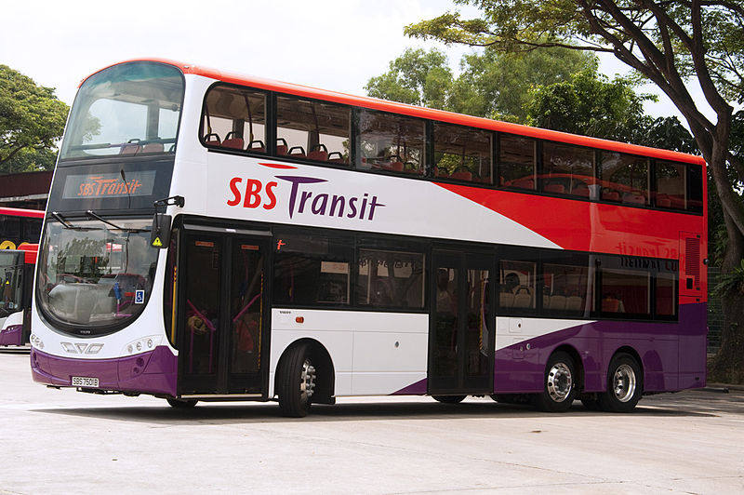
Background
LTA’s Policy Division is keen to optimise bus deployment and service provision based on travel demand
LTA approached GovTech DSD in June 2018 to study this, which could lead to a trial of new ‘optimised’ routes in future

Slide 4
Our Approach
Characterise travel patterns of buses during AM peak hours to identify services that may require route optimisation
Based on discussion with LTA team, priority is to reduce commuter travel time and optimise use of buses while ensuring service provision levels
Where possible, to ‘group’ services based on travel patterns, as similar interventions could possibly be introduced for similar archetypes
Outline possible approaches to devise interventions

Slide 5
Characterising bus route travel patterns

Slide 6
Identifying travel pattern archetypes
LTA staff had suggested that ‘grouping’ services with similar characteristics may enable similar interventions to be rolled for groups of buses
Project team has developed preliminary ‘archetypes’ of loop and non-loop services based
K-Means clustering use to characterise passenger travel patterns along route
Notes:
Divide trunk services into 2 categories - non-loop and loop
Create weighted histograms of cumulative people boarding and alighting along sections of trip for each category
Bins represent proportion of distance in trip
Histograms are normalized to minimize variations across services
Perform K-Means to obtain archetypes of passenger travels for each category

Slide 7
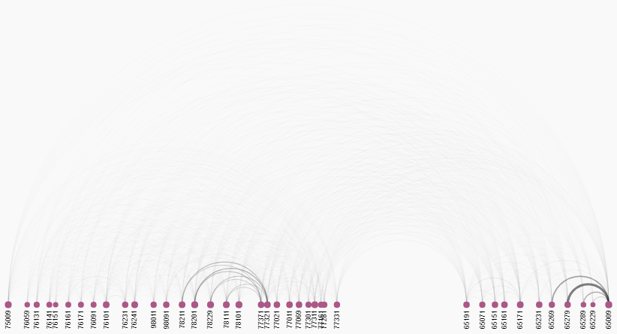
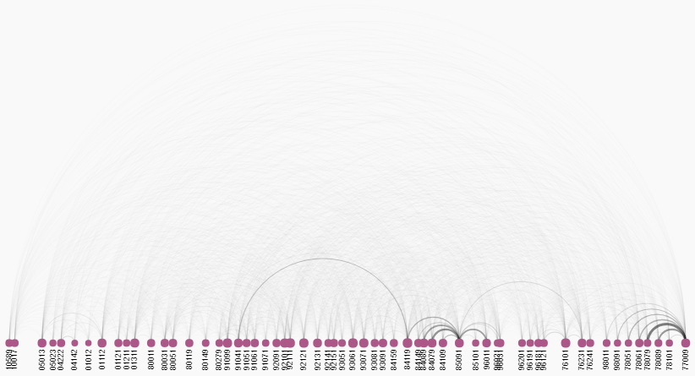
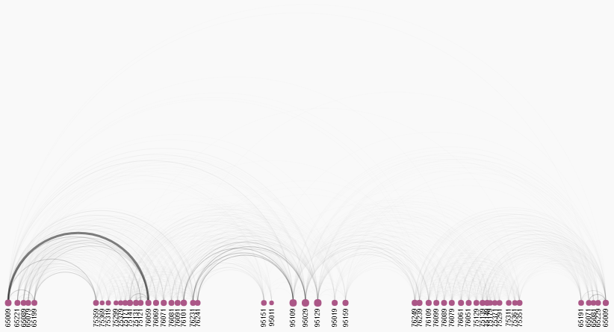
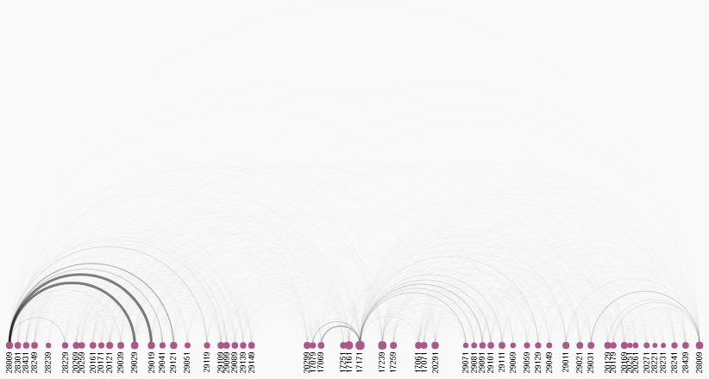
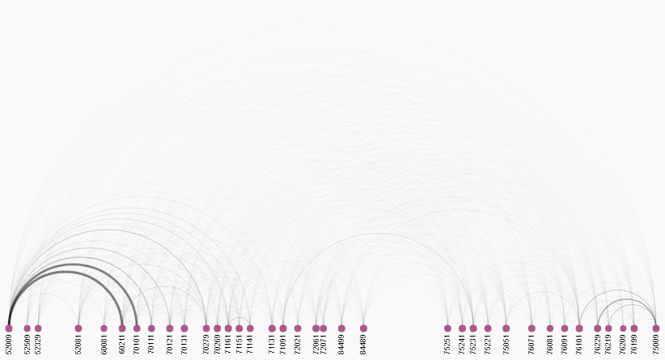
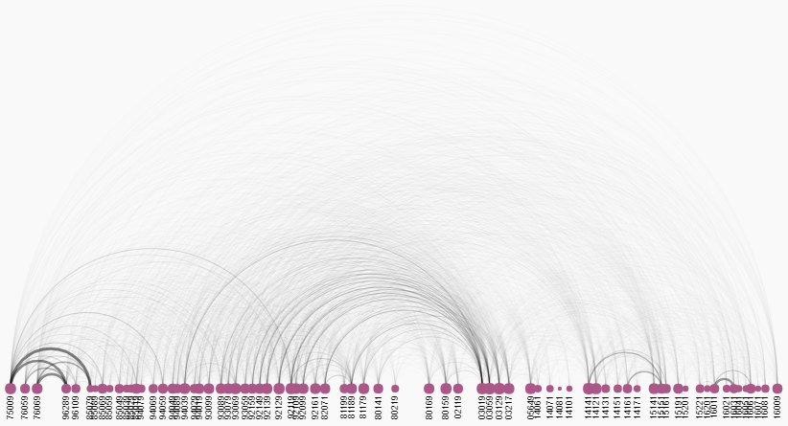
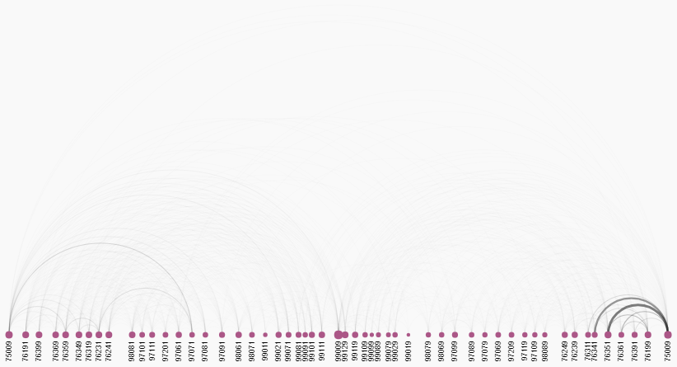
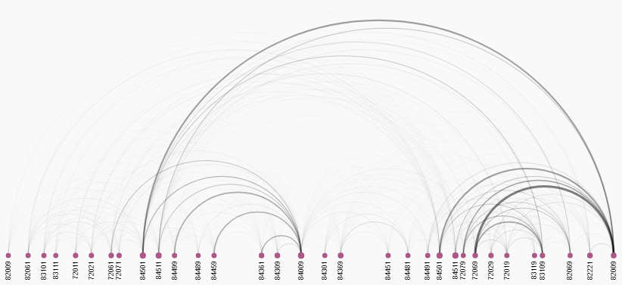
Services’ travel patterns are generally unique, though there are weak clusters
Cluster 1 – Short trips near end of journey with alighting at end of trip
Cluster 3 – Trips originate from start of journey
Service 3 Direction 1
Service 12 Direction 0
Service 34
Service 78
Cluster 2 – Short trips near start of journey with boarding at start of trip
Cluster 4 – Short trips near end of return loop
Service 8 Direction 0
Service 10 Direction 1
Service 29
Service 60

Slide 8
Identifying travel pattern archetypes
Our view is that travel pattern archetypes are unlikely to be useful and should not be the basis for introducing interventions
Dominant clusters (non-loop)
Trips originate from start of journey
Short trips near start of journey
Short trips near middle of journey
Medium length trips in second half of journey
Commuters alight towards end of journey
Short trips near end of journey
Dominant clusters (loop)
Trips originate from start of journey
Short trips in first half of outbound loop
Short trips near middle of outbound loop
Short trips near start of return loop
Short trips in first half of return loop
Short trips near end of return loop
Notes:
Divide trunk services into 2 categories - non-loop and loop
Create weighted histograms of cumulative people boarding and alighting along sections of trip for each category
Bins represent proportion of distance in trip
Histograms are normalized to minimize variations across services
Perform K-Means to obtain archetypes of passenger travels for each category

Slide 9
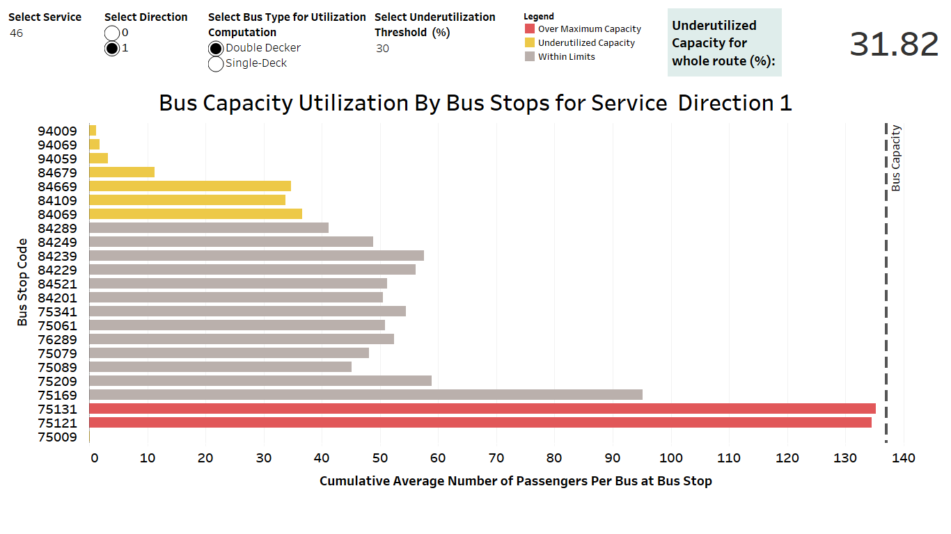
Characterising bus services by utilisation % during AM peak
Improving utilisation (i.e. # pax divided by capacity) would optimise use of buses
Prototype dashboard has been developed to show which services are under/over utilised:
Thresholds can be set by user
Demo
Notes:
Assume 2 bus types:
Double decker – 137 pax capacity
Single deck – 88 pax capacity
For each service and direction, get cumulative average number of people in a bus at each point (bus stop) throughout the trip
Set threshold to identify sections of trips of interest for each service
Currently, underutilized capacity threshold is set between 10-50% of selected bus capacity
Over-utilized capacity threshold is set as 100%

Slide 10
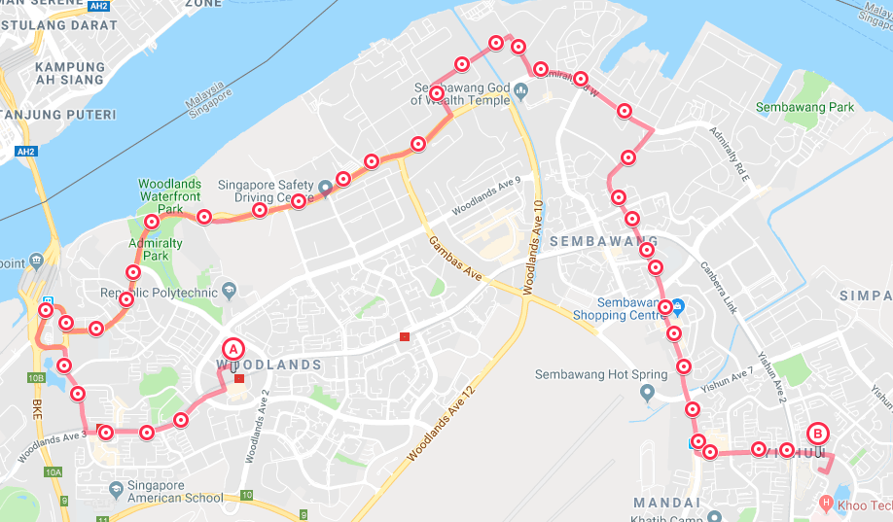
Characterising services by how circuitous they are
Bus journeys are typically longer than equivalent trips made by car
Reducing this ‘detour’ would reduce commuter travel time
Car Travel (Blue) vs. Bus Travel (Red) for Service 856

Slide 11
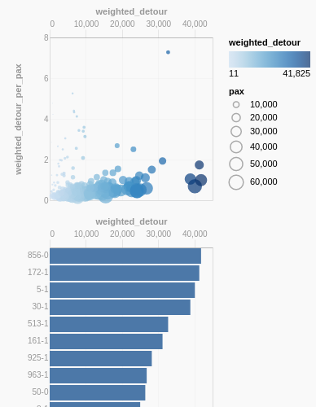
Identifying services with significant detours and no. of commuters
Weighted detour (i.e. no. of commuters x detours in km) is a suitable measure of overall impact
172
856
Notes:
Detour is computed by finding the difference between the distance travelled by the bus following the route, and the distance if the bus travel between 2 points directly
Calculated for all trips during AM peak

Slide 12
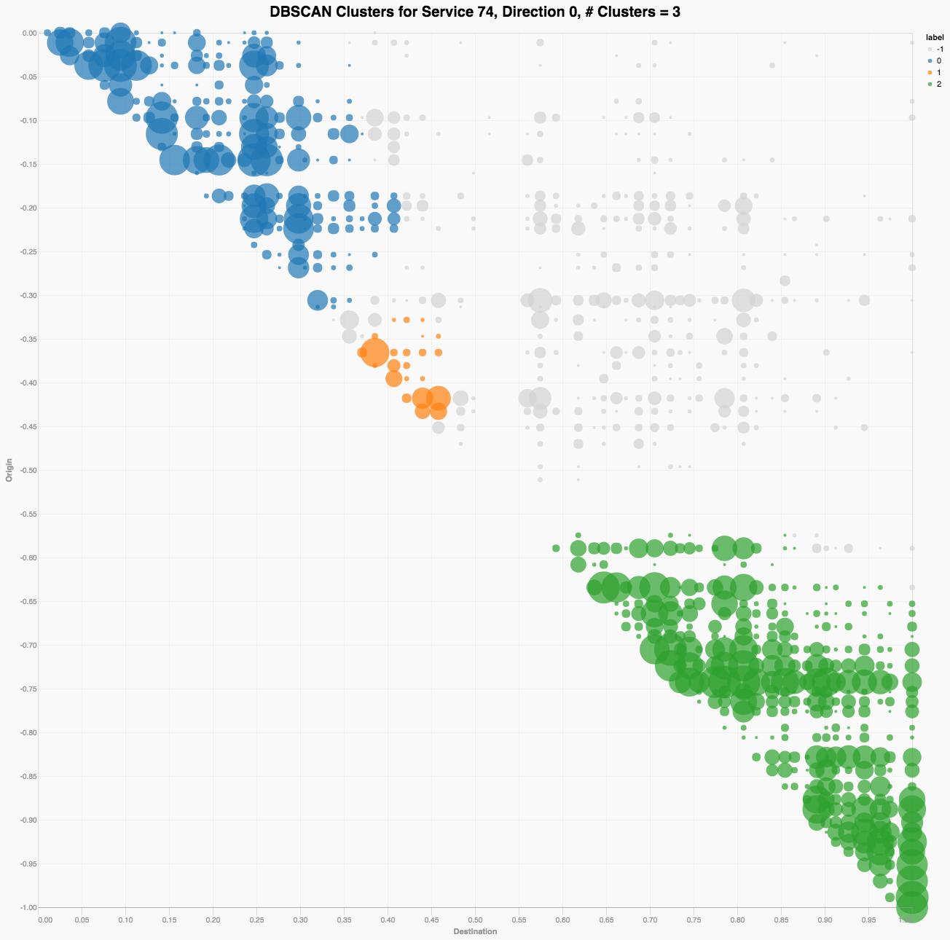
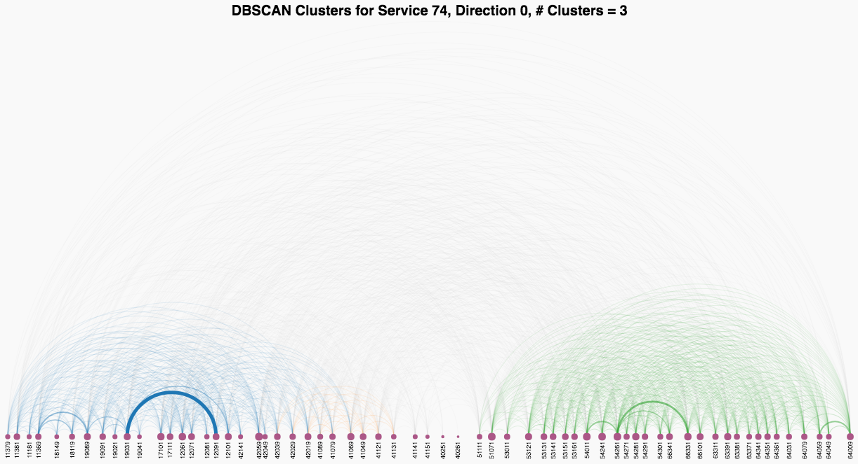
‘Dominant’ travel patterns can also be used to characterise bus service
Arc diagrams & clustering can be used to reveal dominant travel patterns
Interventions can be designed based on these patterns, after routes have been selected using other metrics
Thick band shows large # of commuters travelling between these bus stops
Boarding Stop
Alighting Stop

Slide 13
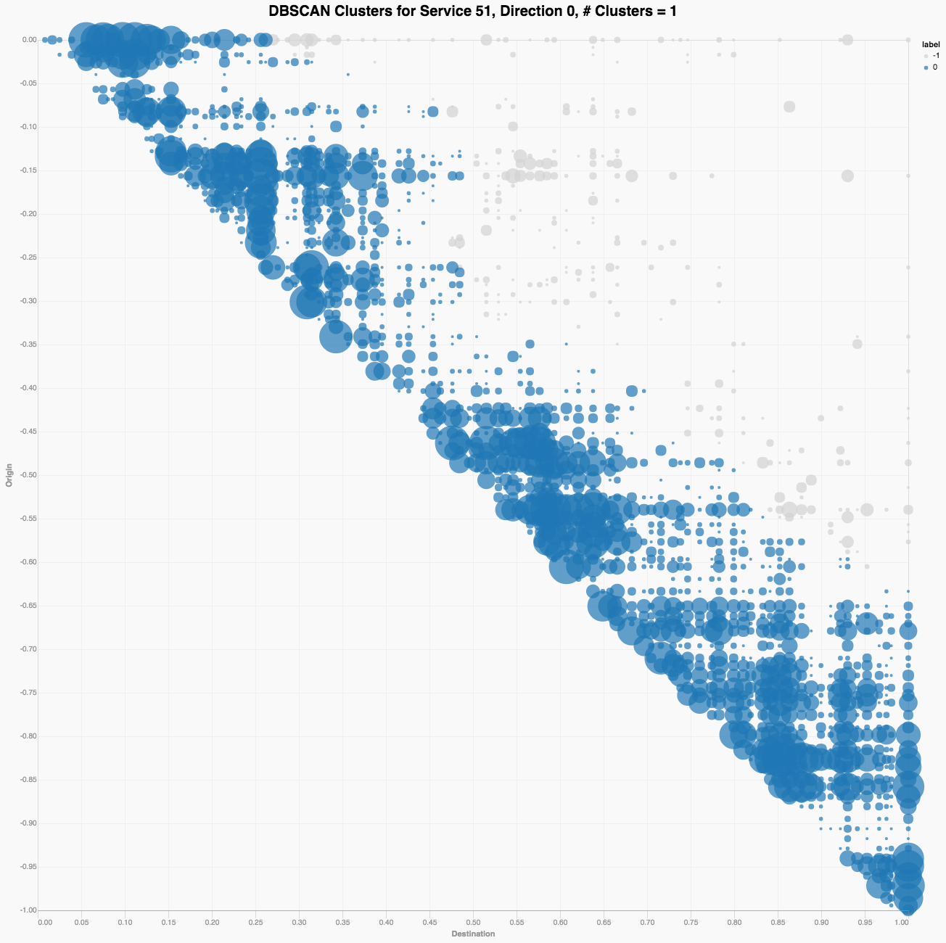
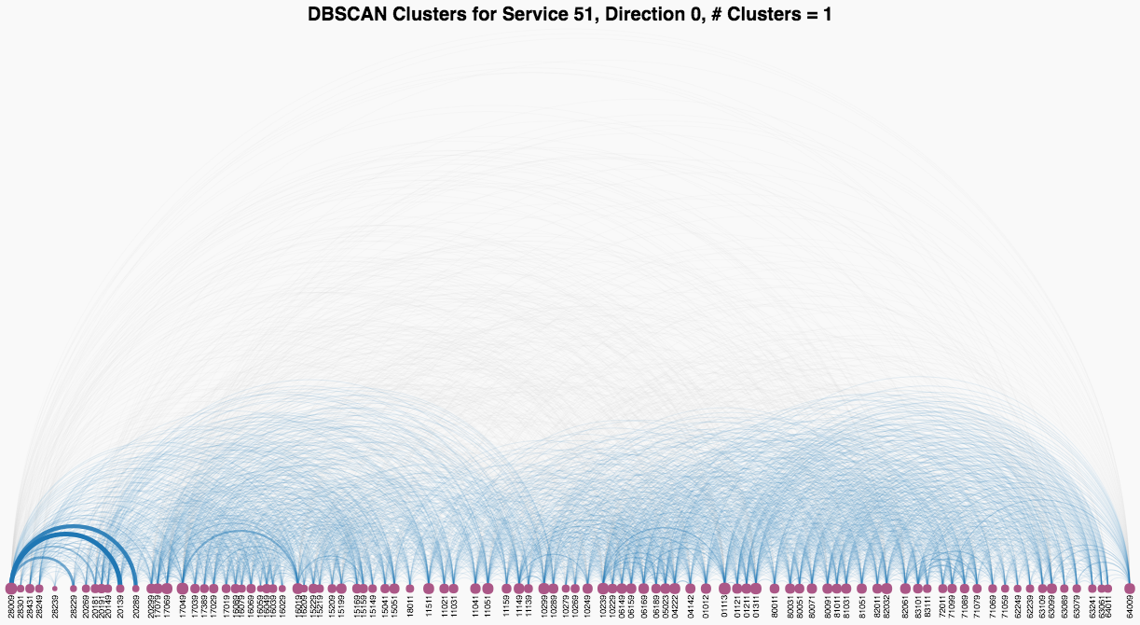
‘Dominant’ travel patterns can also be used to characterise bus service
Single cluster (blue) of origin-destination pairs reveals short trips evenly spread out across route

Slide 14
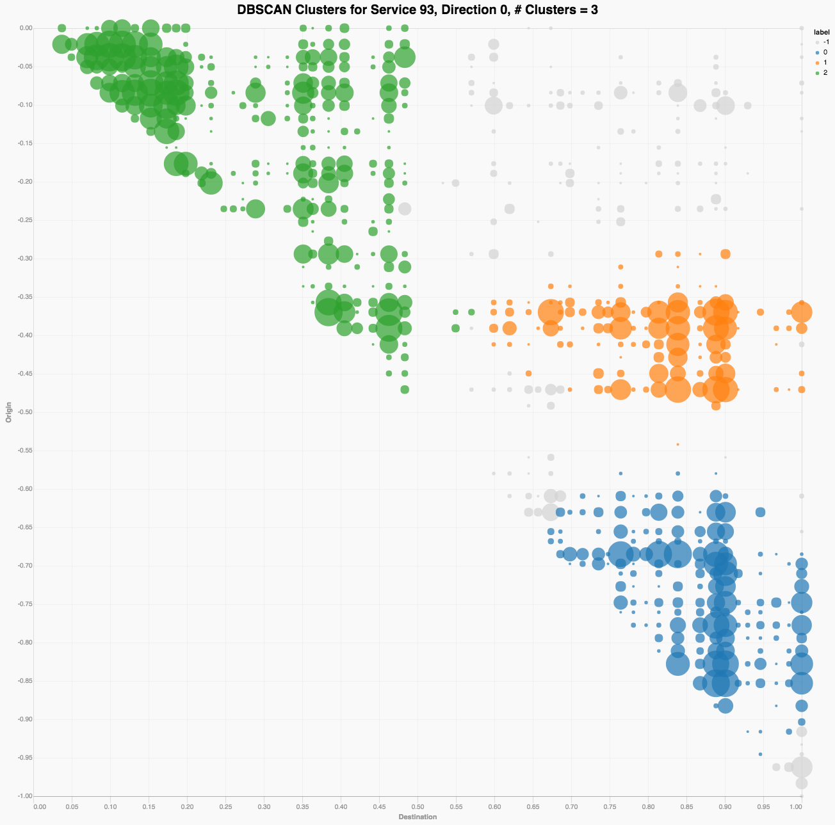
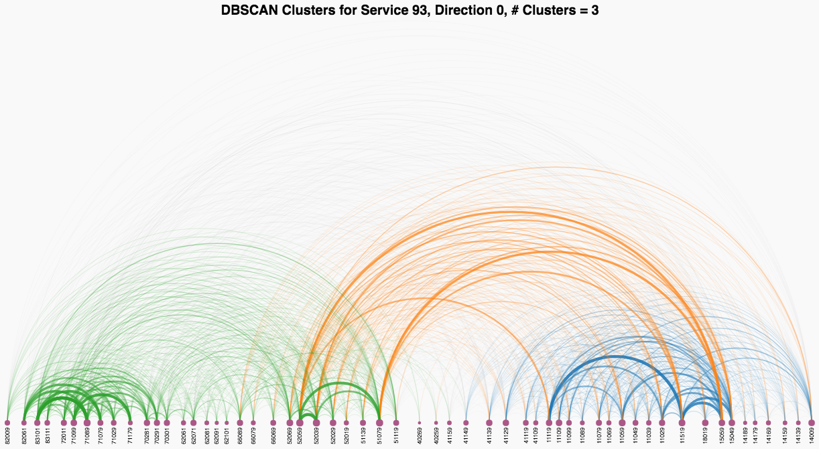
‘Dominant’ travel patterns can also be used to characterise bus service
Three overlapping segments reveals three distinct groups of commuters, with one taking longer trips (orange)

Slide 15
Approach 1 to optimisation:
Reducing travel time by shortening detours along route

Slide 16
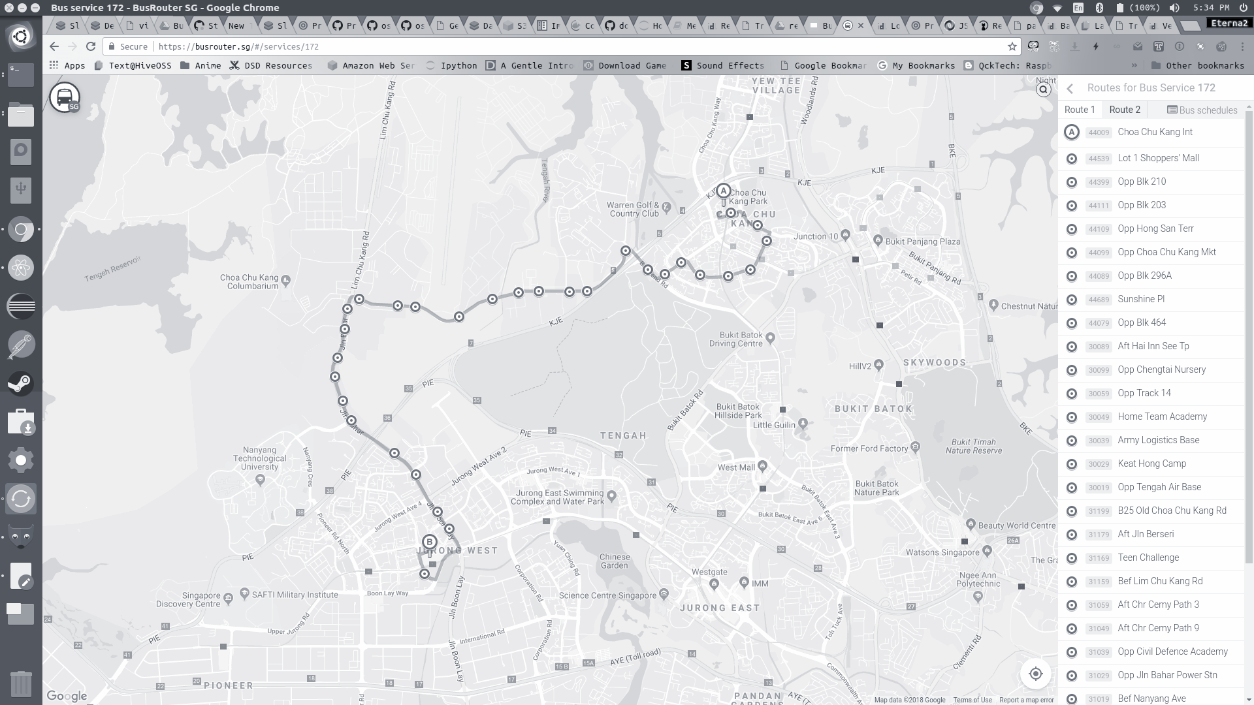
Example I: Riders of service 172 see long detour
to Lim Chu Kang cemetery/camps
CCK
A significant proportion of commuters are going to Jurong West instead of Old Choa Chu Kang Road
Boon Lay

Slide 17
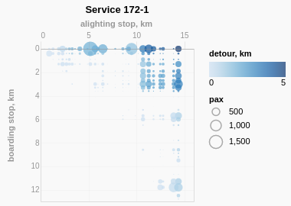
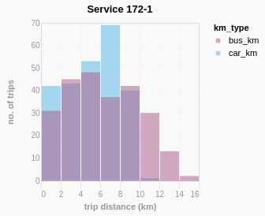
Example I: A direct service between CCK and Jurong West would reduce detour for most riders of service 172
CCK
Boon Lay
Commuters who currently travel 10~16 km can reduce trip distance to < 10 km if a direct route is available
Trips with significant no. of commuters and detour

Slide 18
Example II: A more direct route between Woodlands Interchange and Sembawang would similarly reduce detour for 856 riders

Slide 19
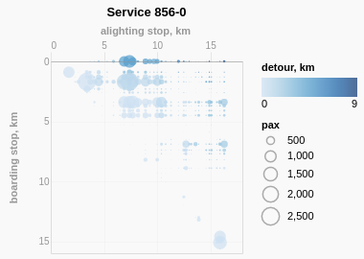
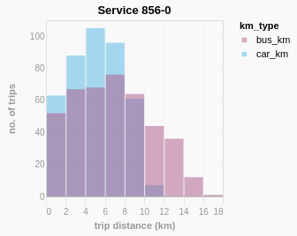
Example II: A more direct route between Woodlands Interchange and Sembawang would similarly reduce detour for 856 riders
Trips with significant no. of commuters and detour
Commuters who used to travel 12~18 km can be reduced to < 12 km if a direct route is available

Slide 20
Approach 2 to optimisation:
Reducing waiting time for majority of commuters along route

Slide 21
Example III: Introducing short-loop service for bus 74 to reduce headway
Bus 74 has three ‘clusters’ of commuter travel:
Buona Vista to Bukit Timah Rd
Along Bukit Timah Rd
Marymount Rd to Hougang Central
Without changing total no. of buses, short loops at #1 & #3 (dominant clusters) can reduce overall commuter waiting times
Making these loops ‘express’ services would further reduce travel time and headway

Slide 22
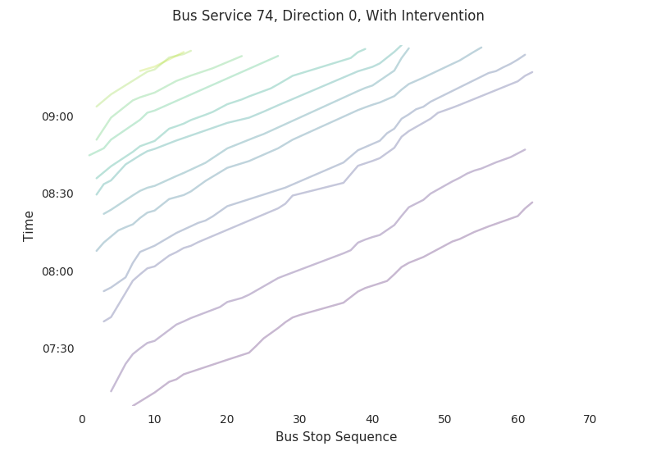
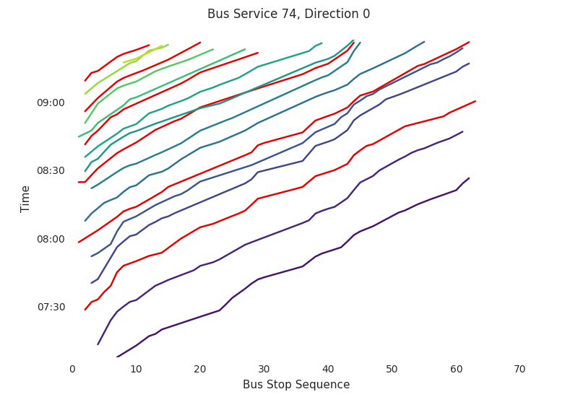
Example III: Introducing short-loop service for bus 74 to reduce headway
Majority of commuters would experience shorter waiting times, reducing cumulative waiting time by 7%
Converting every 3rd bus to a loop
Additional loop services from other direction (not shown)
Truncated Portion
Commuters travelling within segment 1 will be able to board an ‘additional’ 3 buses

Slide 23
For discussion
Hope the investigation into optimisation approaches is useful
Seek LTA’s feedback on the 3 suggested interventions
Decide whether to extend prelim investigation, to full-scale project

